Slide 1
Comp 313
Design and Analysis of Algorithms
Lecture 5 GRAPHS AND ALGORITHMS

Slide 2
Lecture Outline
Introduction
What is a Graph
Application areas
Reading materials

Slide 3
Graphs & Algorithms
A graph can be defined as group of vertices and edges that are used to connect these vertices. A graph can be seen as a cyclic tree, where the vertices (Nodes) maintain any complex relationship among them instead of having parent child relationship.
A graph G can be defined as an ordered set G(V, E) where V(G) represents the set of vertices and E(G) represents the set of edges which are used to connect these vertices.
A Graph G(V, E) with 5 vertices (A, B, C, D, E) and six edges ((A,B), (B,C), (C,E), (E,D), (D,B), (D,A)) is shown in the following figure.
.

Slide 4
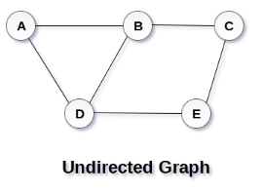
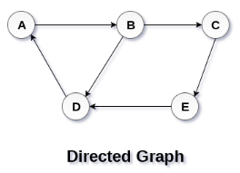

Slide 5
Graph terminologies
Path
A path can be defined as the sequence of nodes that are followed in order to reach some terminal node V from the initial node U.
Closed Path
A path will be called as closed path if the initial node is same as terminal node. A path will be closed path if V₀=V_{N}.
Simple Path
If all the nodes of the graph are distinct with an exception V₀=V_{N}, then such path P is called as closed simple path.

Slide 6
Cycle
A cycle can be defined as the path which has no repeated edges or vertices except the first and last vertices.
Connected Graph
A connected graph is the one in which some path exists between every two vertices (u, v) in V. There are no isolated nodes in connected graph.
Complete Graph
A complete graph is the one in which every node is connected with all other nodes. A complete graph contain n(n-1)/2 edges where n is the number of nodes in the graph.

Slide 7
Weighted Graph
In a weighted graph, each edge is assigned with some data such as length or weight. The weight of an edge e can be given as w(e) which must be a positive (+) value indicating the cost of traversing the edge.
Digraph
A digraph is a directed graph in which each edge of the graph is associated with some direction and the traversing can be done only in the specified direction.
Loop
An edge that is associated with the similar end points can be called as Loop.
Adjacent Nodes
If two nodes u and v are connected via an edge e, then the nodes u and v are called as neighbours or adjacent nodes.
Degree of the Node
A degree of a node is the number of edges that are connected with that node. A node with degree 0 is called as isolated node.

Slide 8
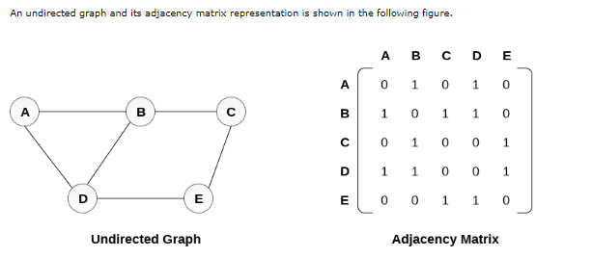
Graph representation
.

Slide 9
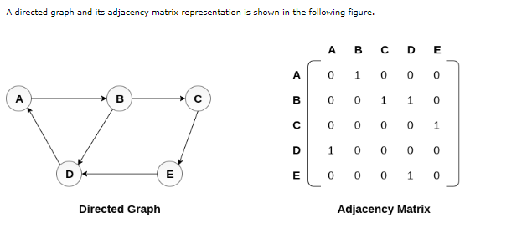

Slide 10
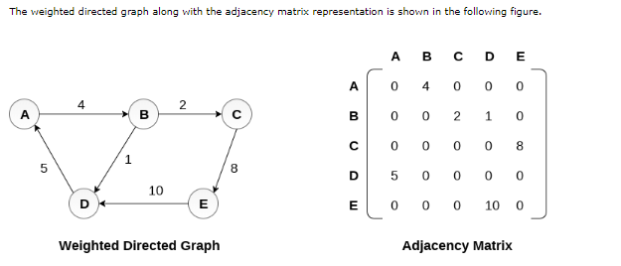

Slide 11
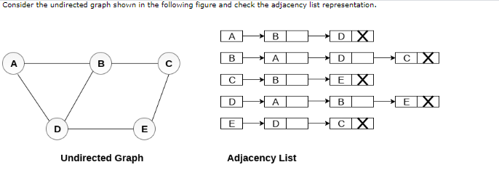

Slide 12
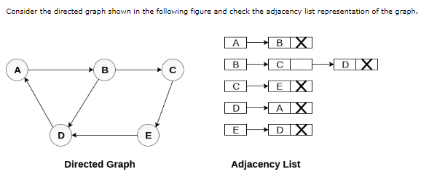

Slide 13
Graph Traversal Algorithm
Traversing the graph means examining all the nodes and vertices of the graph. There are two standard methods .
Breadth First Search
Depth First Search

Slide 14
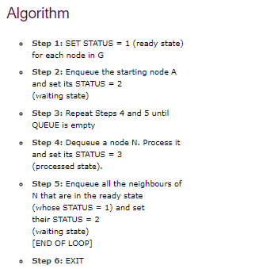
Breadth First Search

Slide 15
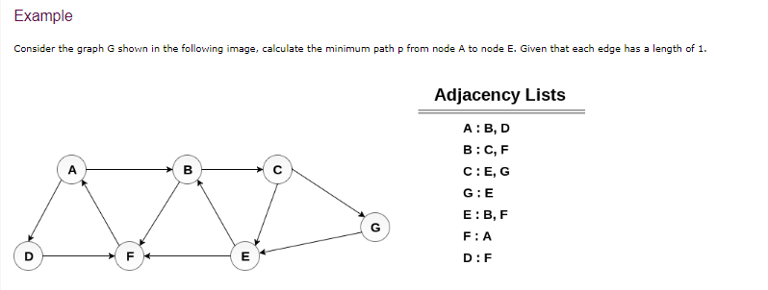

Slide 16
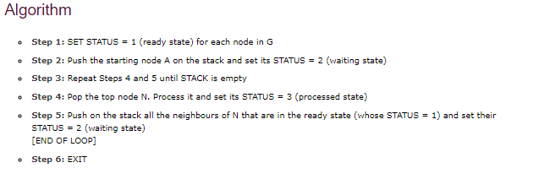
DFS
.

Slide 17
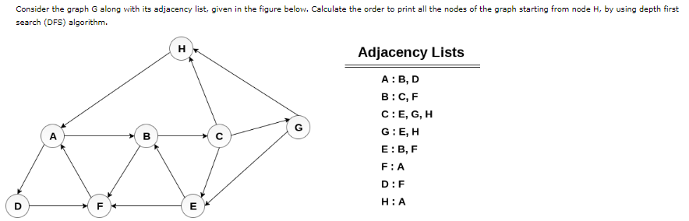

Slide 18
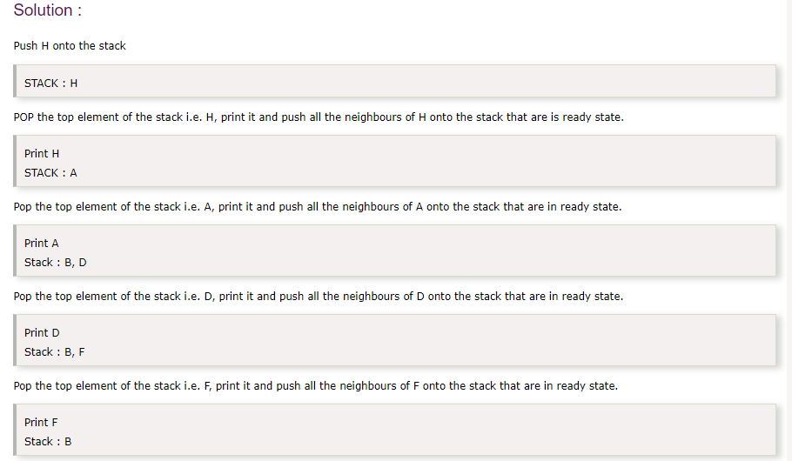

Slide 19
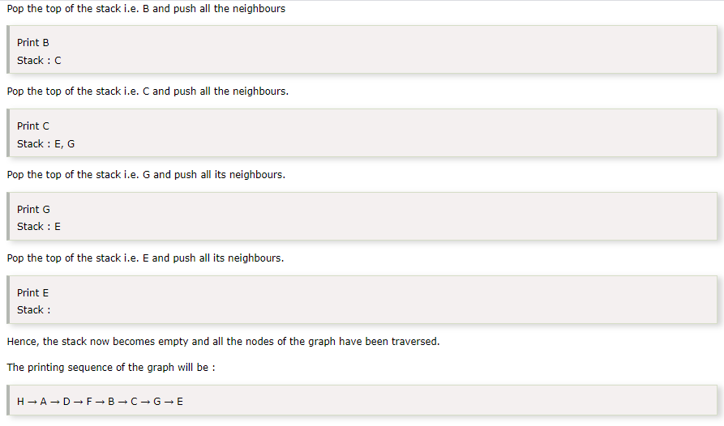

Slide 20
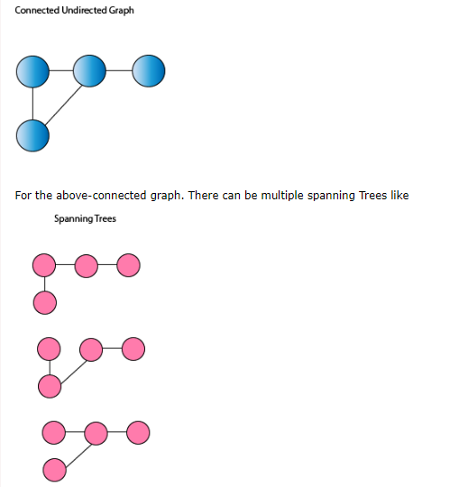
Spanning tree
Given a connected undirected graph, a spanning tree of that graph is a subgraph that is a tree and joined all vertices. A single graph can have many spanning trees.

Slide 21
Properties of Spanning Tree.
There may be several minimum spanning trees of the same weight having the minimum number of edges.
If all the edge weights of a given graph are the same, then every spanning tree of that graph is minimum.
If each edge has a distinct weight, then there will be only one, unique minimum spanning tree.
A connected graph G can have more than one spanning trees.
A disconnected graph can't have to span the tree, or it can't span all the vertices.
Spanning Tree doesn't contain cycles.
Spanning Tree has (n-1) edges where n is the number of vertices.
Addition of even one single edge results in the spanning tree losing its property of Acyclicity and elimination of one single edge results in its losing the property of connectivity.

Slide 22
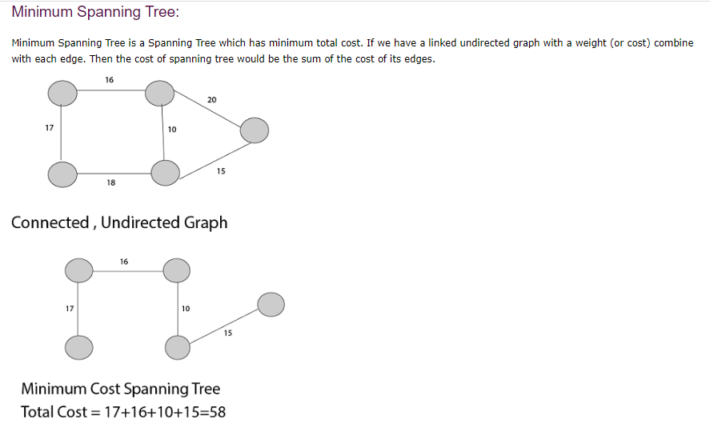

Slide 23
Application of Minimum Spanning Tree
1. Consider n stations are to be linked using a communication network & laying of communication links between any two stations involves a cost. The ideal solution would be to extract a subgraph termed as minimum cost spanning tree.
2. Suppose you want to construct highways or railroads spanning several cities then we can use the concept of minimum spanning trees.
3. Designing Local Area Networks.
4. Laying pipelines connecting offshore drilling sites, refineries and consumer markets.
5. Suppose you want to apply a set of houses with
Electric Power
Water
Telephone lines
Sewage lines
To reduce cost, you can connect houses with minimum cost spanning trees.

Slide 24
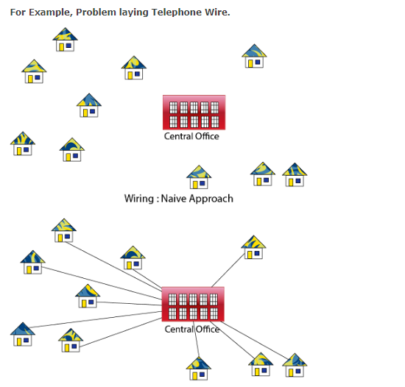

Slide 25
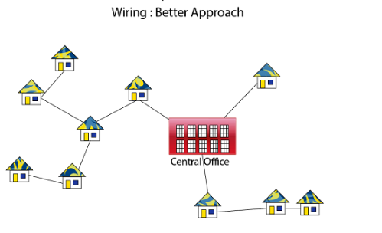

Slide 26
Minimum Spanning Tree Algorithms
There are two methods to find Minimum Spanning Tree
Kruskal's Algorithm
Prim's Algorithm
Kruskal's Algorithm:
An algorithm to construct a Minimum Spanning Tree for a connected weighted graph. It is a Greedy Algorithm. The Greedy Choice is to put the smallest weight edge that does not because a cycle in the MST constructed so far.

Slide 27
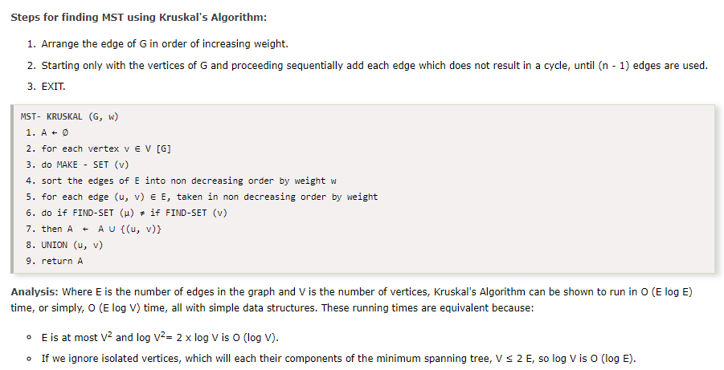


Slide 28
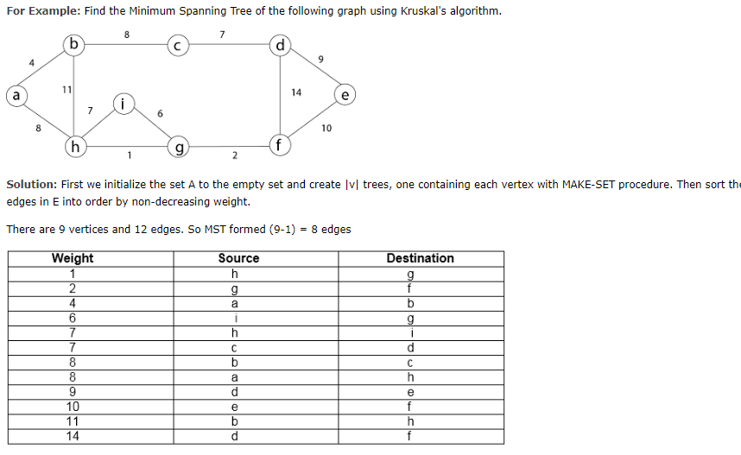

Slide 29
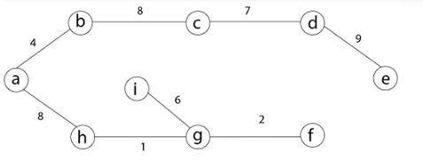
Final MST
Minimum Spanning Tree because it contains all the 9 vertices and (9 - 1) = 8 edges
MST=45

Slide 30
Prim's Algorithm
It is a greedy algorithm. It starts with an empty spanning tree. The idea is to maintain two sets of vertices:
Contain vertices already included in MST.
Contain vertices not yet included.
At every step, it considers all the edges and picks the minimum weight edge. After picking the edge, it moves the other endpoint of edge to set containing MST.

Slide 31
Steps for finding MST using Prim's Algorithm:
Create MST set that keeps track of vertices already included in MST.
Assign key values to all vertices in the input graph. Initialize all key values as INFINITE (∞). Assign key values like 0 for the first vertex so that it is picked first.
While MST set doesn't include all vertices.
Pick vertex u which is not is MST set and has minimum key value. Include 'u'to MST set.
Update the key value of all adjacent vertices of u. To update, iterate through all adjacent vertices. For every adjacent vertex v, if the weight of edge u.v less than the previous key value of v, update key value as a weight of u.v.

Slide 32
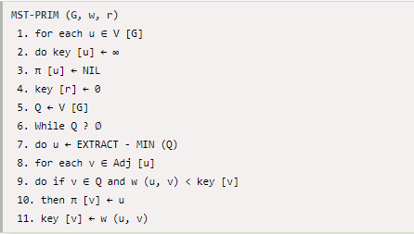
Algorithm

Slide 33
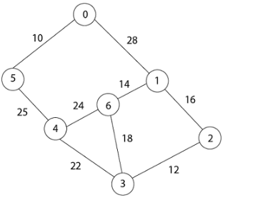
Example

Slide 34
Solution:
In Prim's algorithm, first we initialize the priority Queue Q. to contain all the vertices and the key of each vertex to ∞ except for the root, whose key is set to 0. Suppose 0 vertex is the root, i.e., r. By EXTRACT - MIN (Q) procure, now u = r and Adj [u] = {5, 1}.
Removing u from set Q and adds it to set V - Q of vertices in the tree. Now, update the key and π fields of every vertex v adjacent to u but not in a tree.

Slide 35
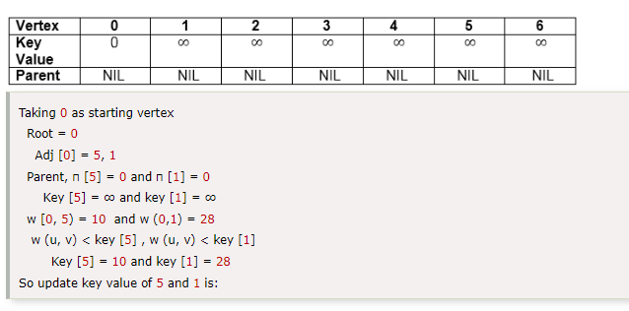

Slide 36
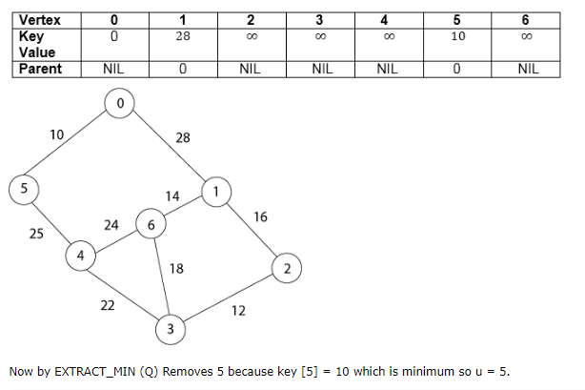

Slide 37
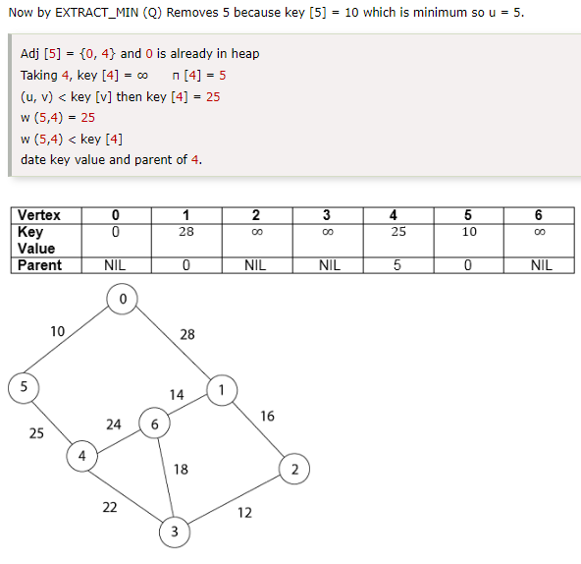

Slide 38
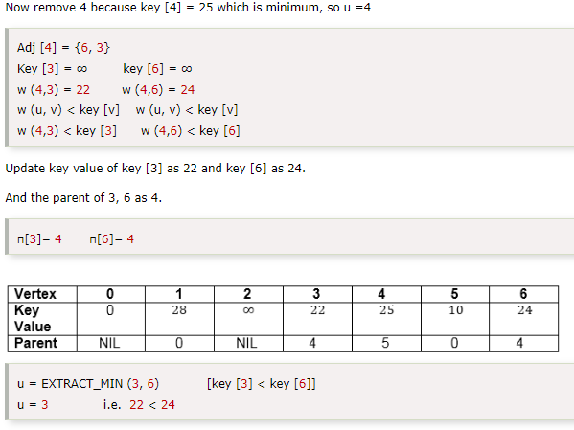

Slide 39
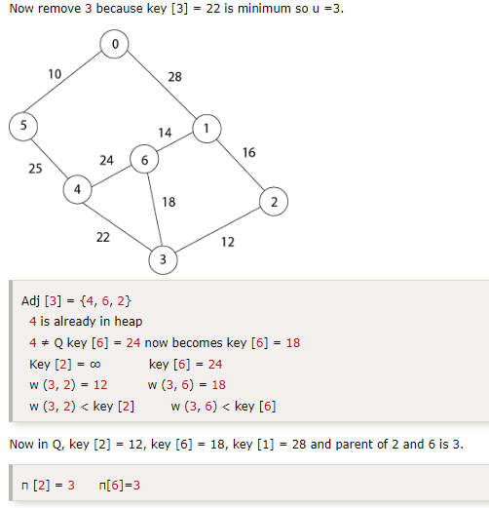

Slide 40
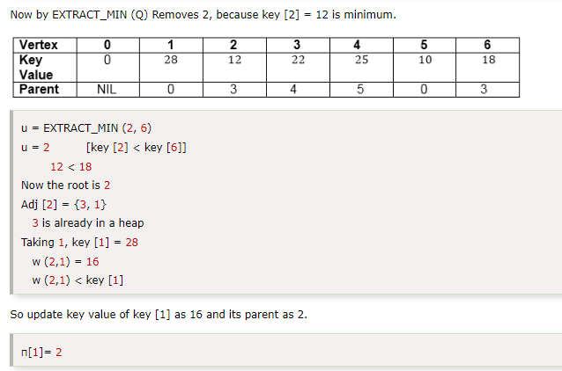

Slide 41
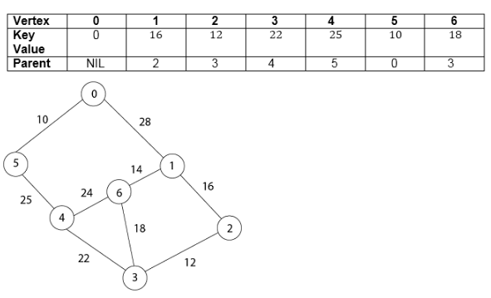

Slide 42
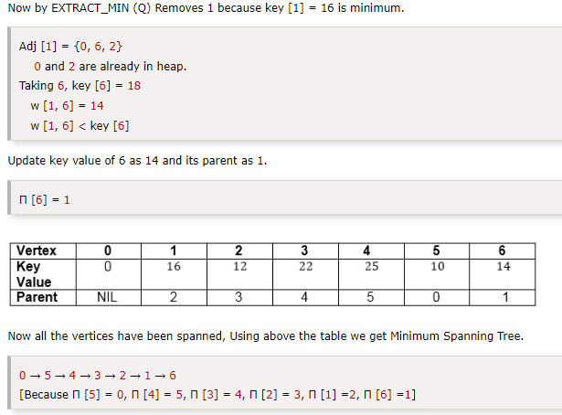

Slide 43
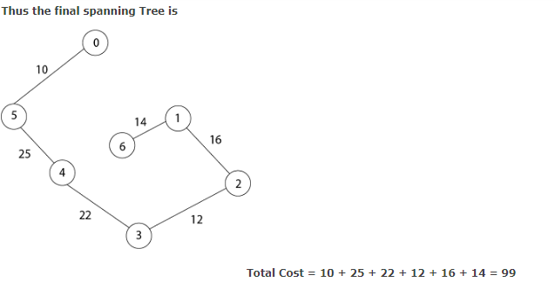

Slide 44
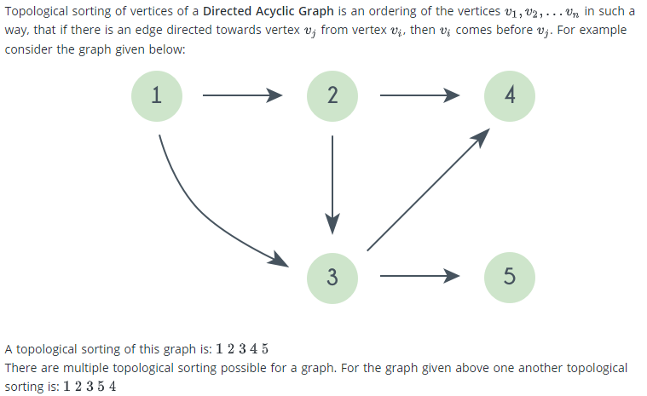
Topological sorting

Slide 45
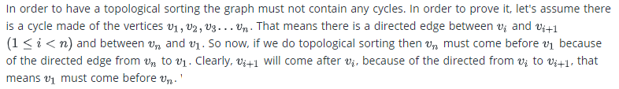
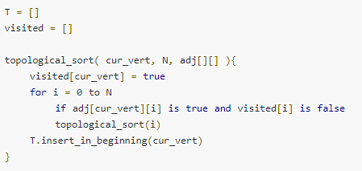

Slide 46
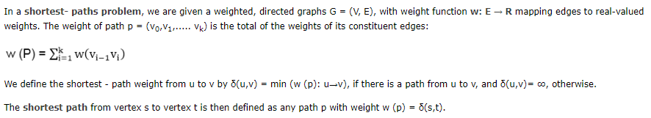
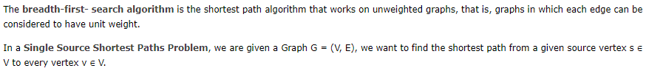
Shortest path algorithms

Slide 47
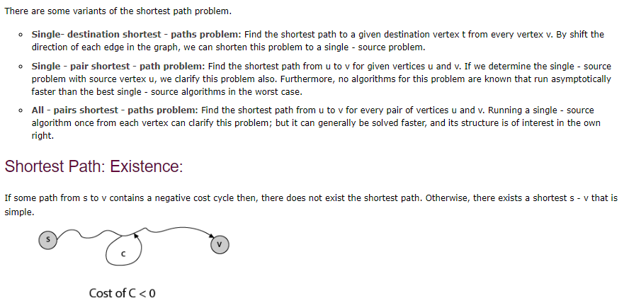
Variants

Slide 48
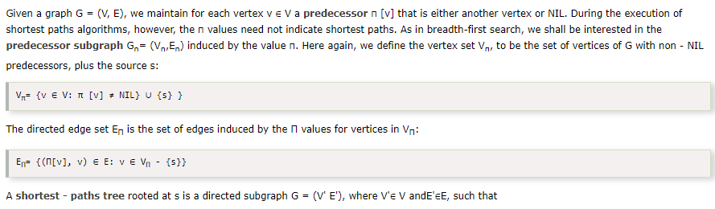
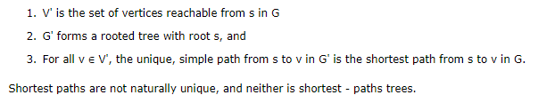
Representing: Shortest Path

Slide 49
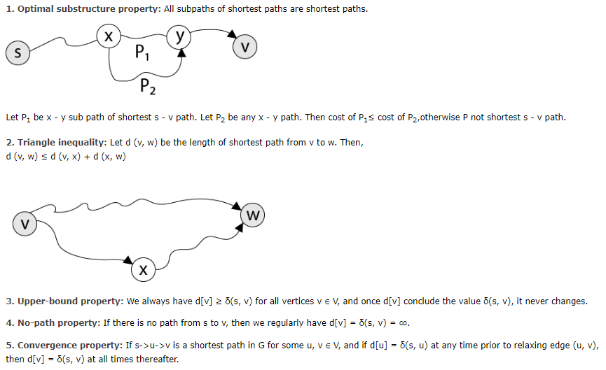
Properties of shortest path

Slide 50
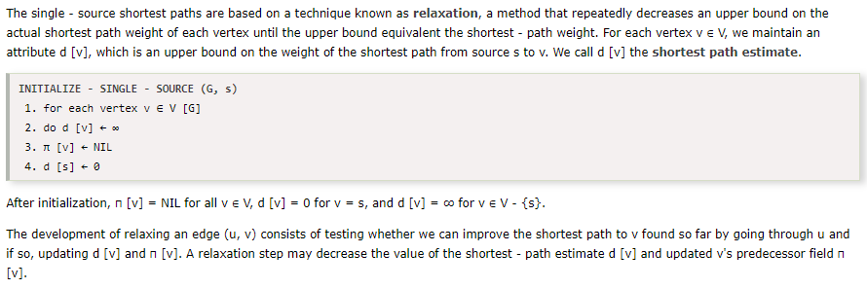
Relaxation

Slide 51
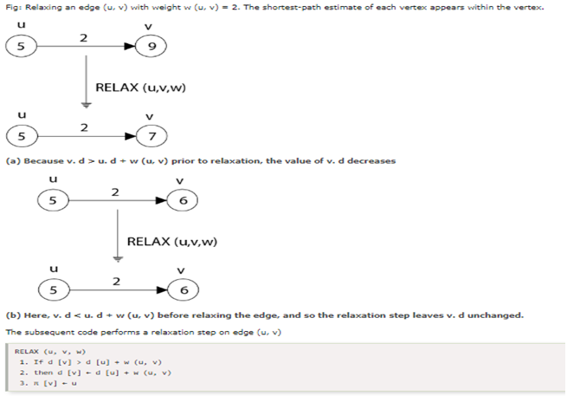

Slide 52
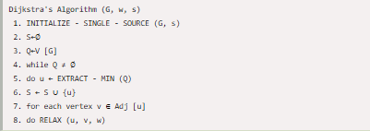
Dijkstra,s
It is a greedy algorithm that solves the single-source shortest path problem for a directed graph G = (V, E) with nonnegative edge weights, i.e., w (u, v) ≥ 0 for each edge (u, v) ∈ E.
Dijkstra's Algorithm maintains a set S of vertices whose final shortest - path weights from the source s have already been determined. That's for all vertices v ∈ S; we have d [v] = δ (s, v). The algorithm repeatedly selects the vertex u ∈ V - S with the minimum shortest - path estimate, insert u into S and relaxes all edges leaving u.
Because it always chooses the "lightest" or "closest" vertex in V - S to insert into set S, it is called as the greedy strategy.

Slide 53
REFERENCE MATERIALS
The design and Analysis of Computer Algorithms by AHO/Hocroft Ullman
Design and analysis of Algorithms by Russell L Shackelford
Introduction to the Design and Analysis of Algorithms by R.C.T Lee, S.S Tseng Chang Y.T Tsai
Judith L GerstingMathematical Structures for computer science 4th edition

